Slide 1


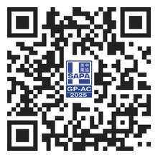
Evolving Landscape of Biopharma
Navigating from discovery to commercialization
Friday, March 14th &
Saturday, March 15th, 2025
Sheraton Valley Forge Hotel
480 N Gulph Rd
King of Prussia, PA 19406
<Name>, <Credential>.
<Title>
<Company Name>
  REGISTER NOW
  WE ARE SPONSING
sapagp.org/event/sapa-gp-2025-annual-conference/

